Slide 1
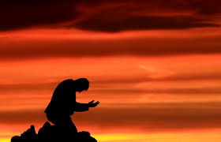
Take My Life and Let It Be
献己于主

Slide 2
Take my life and let it be Consecrated Lord to Thee
Take my hands and let them move At the impulse of Thy Love (2X)
我一生求主管理 愿献身心为活祭
我光阴全归主用 还不够报主恩宠

Slide 3
Take my feet and let them be Swift and beautiful for Thee
Take my voice and let me sing Always only for my King (2X)
我双手为主作工 因被主慈爱感动
使我脚为主行路 快如飞从主吩咐

Slide 4
Take my lips and let them be Filled with messages for Thee
Take my silver and my gold Not a mite would I withhold (2X)
使我口时常颂扬
赞美我荣耀君王
使我口满有主言
各处宣讲在人前

Slide 5
Take my love, my God I pour at Thy feet its treasures store
Take myself and I will be Ever, only, all for Thee (2X)
愿虔诚献上金银
不为自己留分文
我智慧并我才能
办主事赤胆忠诚

